Slide 1
Facial Emotion Recognition under Noisy Environment

Slide 2
Introduction
Challenges faced by FER is ability to deal with complicated environmental conditions such as noisy environments
Human facial expressions can be easily classified into 7 basic emotions: happy, sad, surprise, fear, anger, disgust, and neutral.
This project aims to classify these 7 emotions under noisy environments using empirical mode decomposition(EMD) and Support Vector Machine(SVM)
A series of experiment would be conducted on Cohn-Kennedy database to recognize the emotion by minimizing the effect of noise.

Slide 4
Cohn Kannade Database
It is used for research in automatic facial image analysis and synthesis and for perceptual studies.
We are using the 2nd version of CK database called as CK+. It includes both posed and non-posed (spontaneous) expressions and additional types of metadata.
This database is fully FACS(Facial Action Coding System) coded.
The selection criteria used in this experiment are as follows:
i. About 266 images sequences are selected from the database. The sequence could be labeled as one of the six basic emotions. The subjects that contain 4 - 6 emotions per sequence are considered.
ii. The database comprises of 80 subjects that varies among ages (18 – 30 years), ethnicities (African-American and Asian) and genders (male and female).

Slide 6
Face Detection
The original facial image of size m x n pixels is cropped into 100 x 100 pixels
we have used various Haar Cascades for detection of various face features using detectMultiScale functions.
Haar is a feature based cascade classifier for object detection. Initially, the algorithm needs a lot of positive images (images of faces) and negative images (images without faces) to train the classifier.
For this, haar features shown in below image are used.

Slide 7
Radon Transform
If a function f represents an unknown density, then the Radon transform represents the projection data obtained as the output of a tomographic scan.
We have used Radon transform to project our 2D facial image into a 1D signal that will be preserved by Radon transform before applying the feature extraction technique.

Slide 8
Empirical Mode Decomposition
Using the EMD method, any complicated data set can be decomposed into a finite and often small number of components.
EMD adaptively decomposes any complicated signal into “monocomponent functions” socalled intrinsic mode functions (IMFs) via a sifting process
EMD technique enables to minimize the effect of the noise in classifying the facial emotion

Slide 9
PCA plus LDA
Pattern recognitions biggest problem is singularity of the input signal. The number of samples is much smaller than the number of features
PCA +LDA is used to project the high dimensional space to a lower dimensional space. Thus making the Sw no more singular.
This can be done by mapping the PCA space to f large eigenvalues and then employing LDA to reduce dimension

Slide 10
SVM
Support Vector Machine taking a given labeled training data (supervised learning), the algorithm outputs an optimal hyperplane which categorizes new examples.
For a linearly separable set of 2D-points which belong to one of two classes, find a separating straight line.
The operation of the SVM algorithm is based on finding the hyperplane that gives the largest minimum distance to the training examples.

Slide 11
Implementation steps

Slide 12
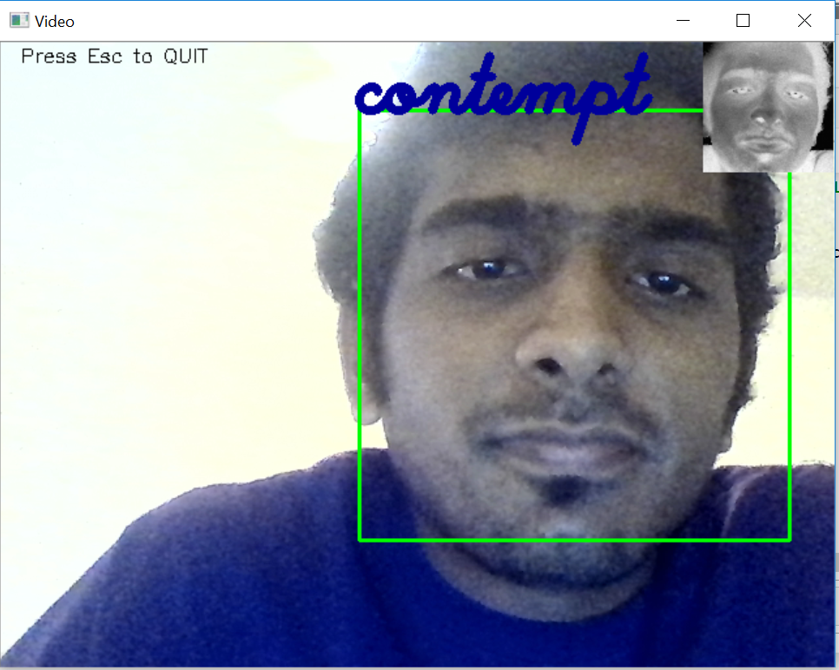
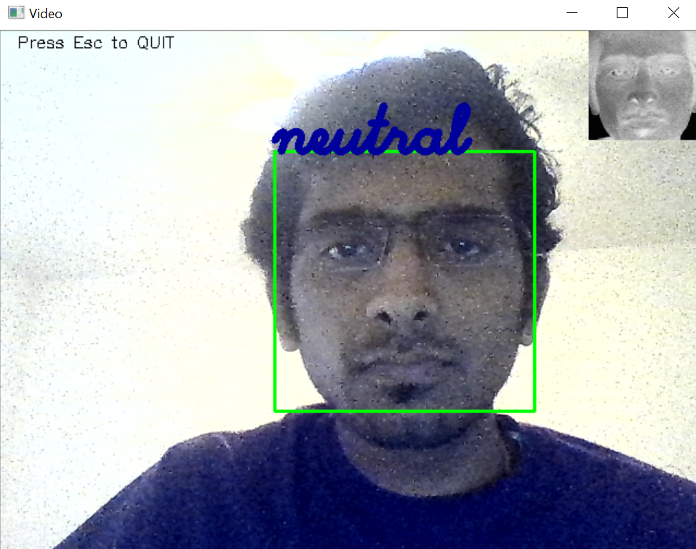
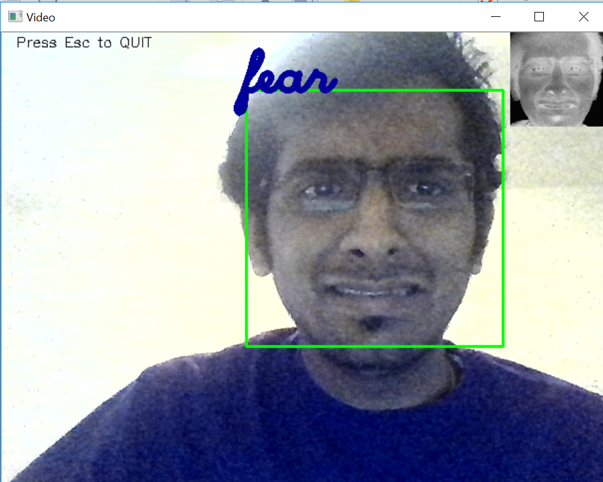
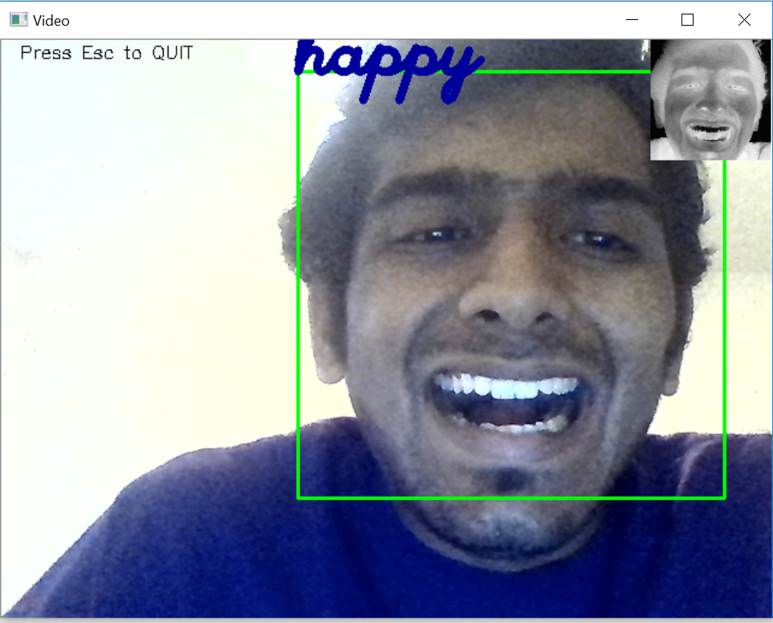
Live Emotion Detection

